Slide 1
Government Spending Comparison
Anthony Bible
BIT 3444 | Summer 2025

Slide 2
Objective
Compare per capita and % of GDP spending across countries for:
Education
Healthcare
Military

Slide 3
Data Sources
World Bank (Education, Healthcare, Population, GDP)
SIPRI (Military)
Year: 2023 or most recent available

Slide 4
Methodology
Downloaded raw data from official sources
Filtered top 10 countries with complete data
Cleaned and merged data
Calculated per capita spending for each sector

Slide 5
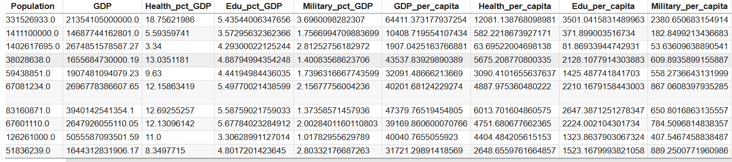
Summary Table
See CSV/Excel file for full view of data including:

Slide 6
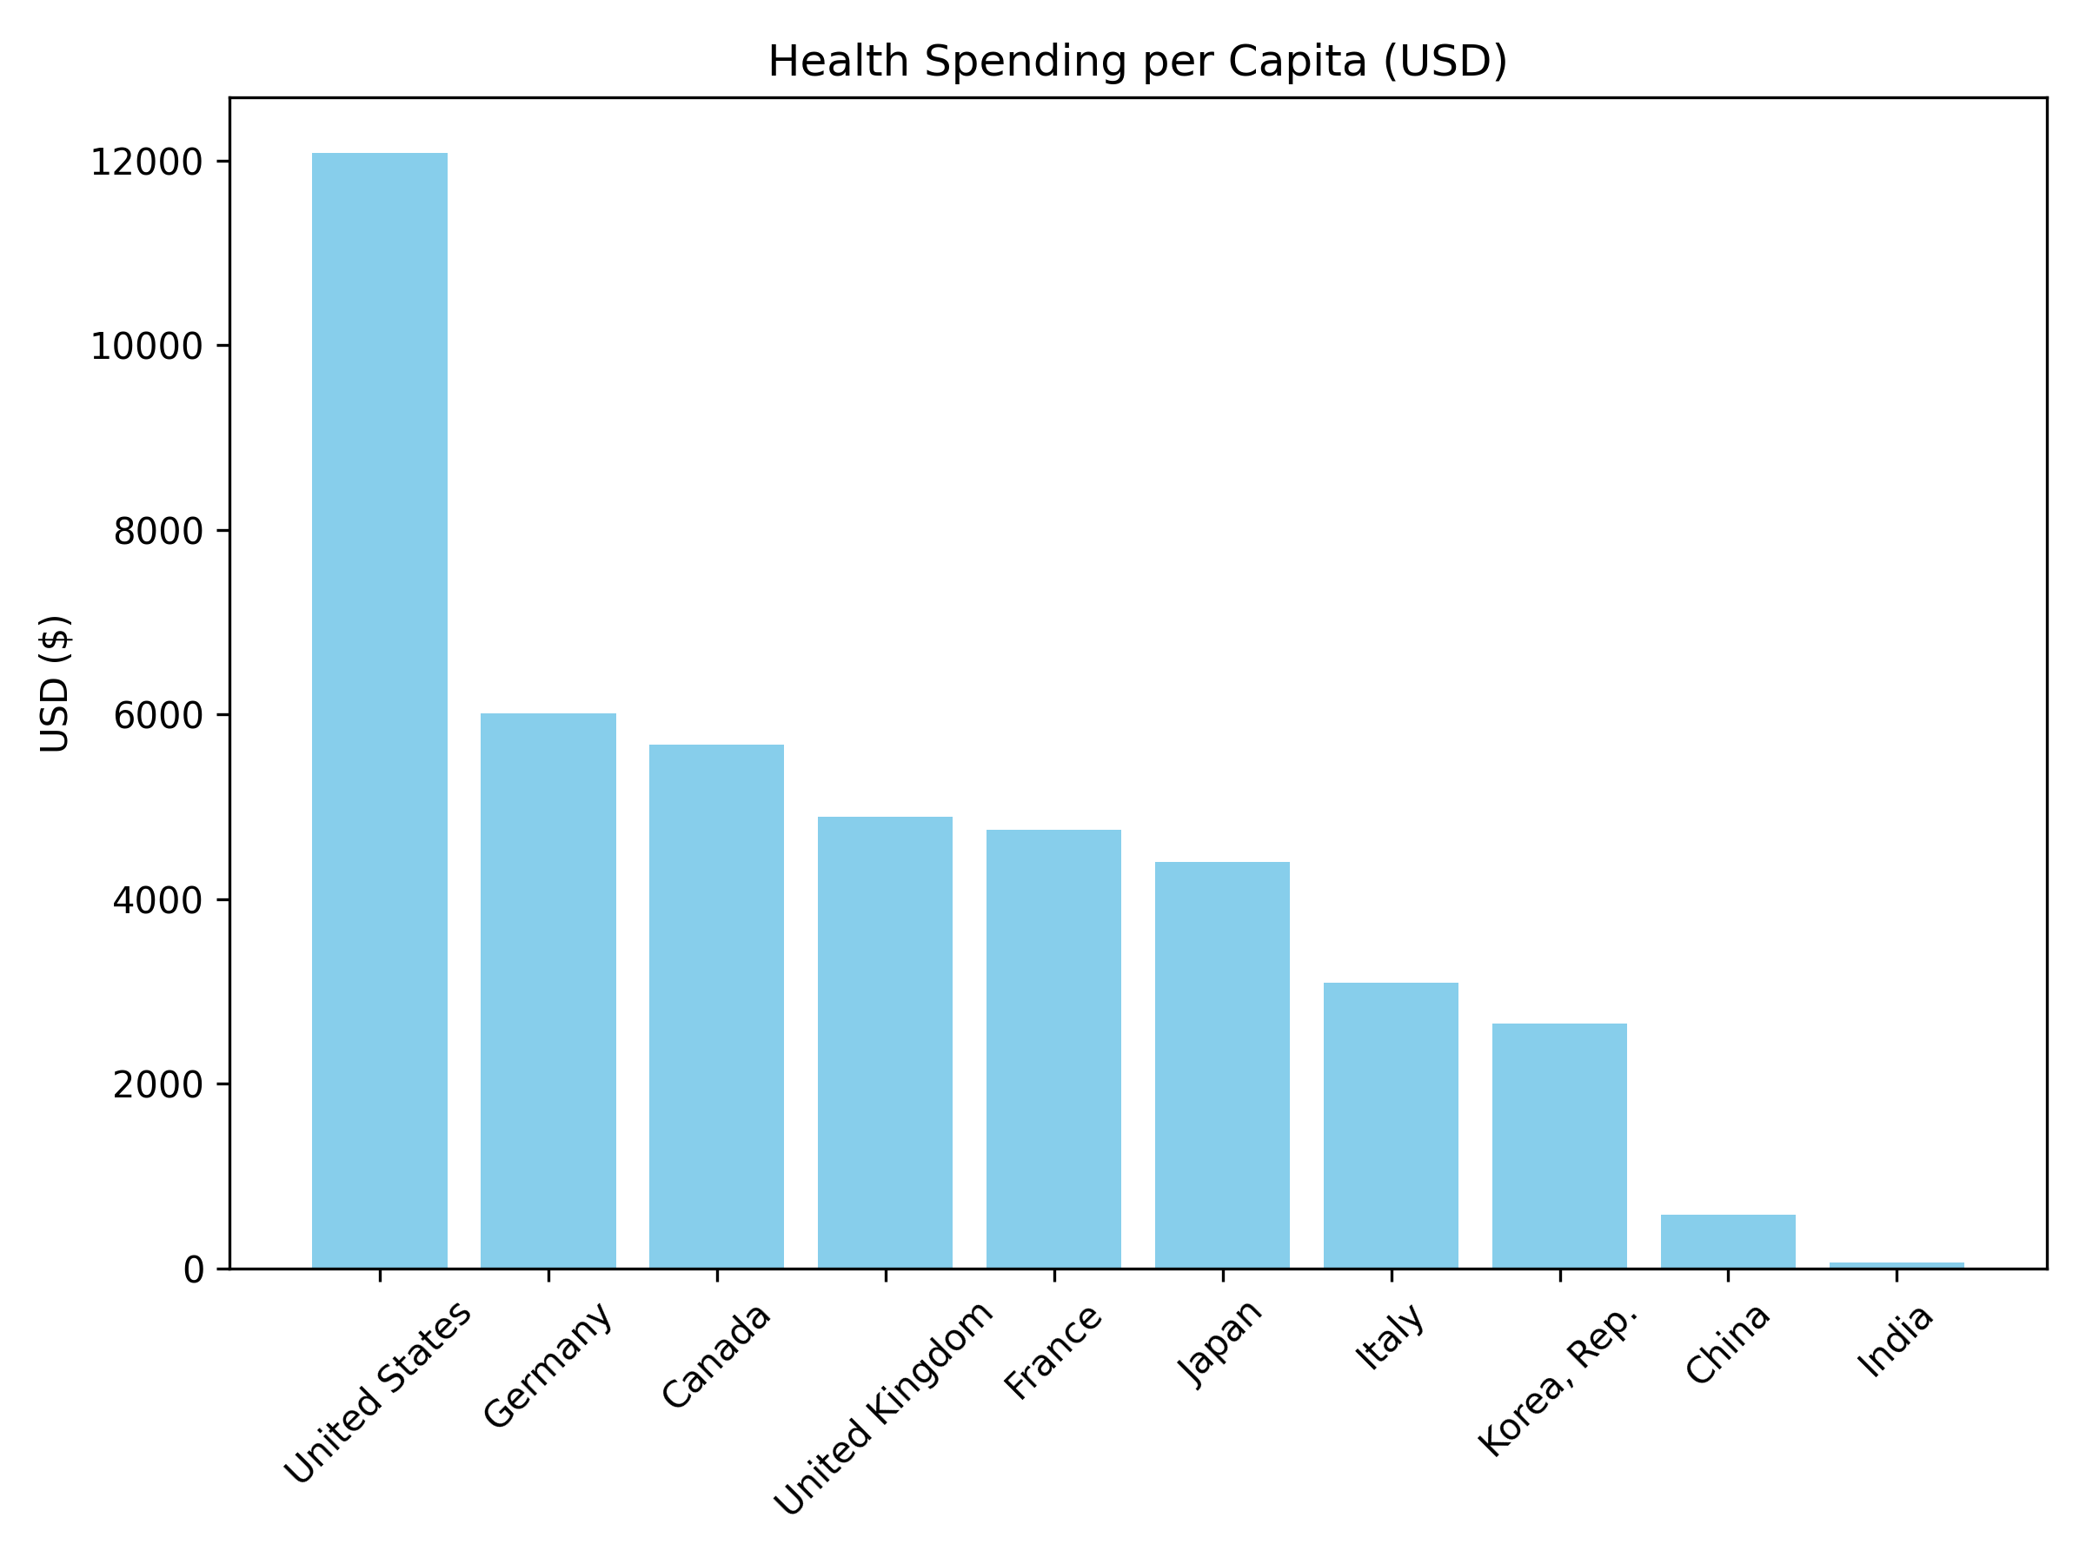
Health Spending per Capita
- Countries in descending order by USD

Slide 7
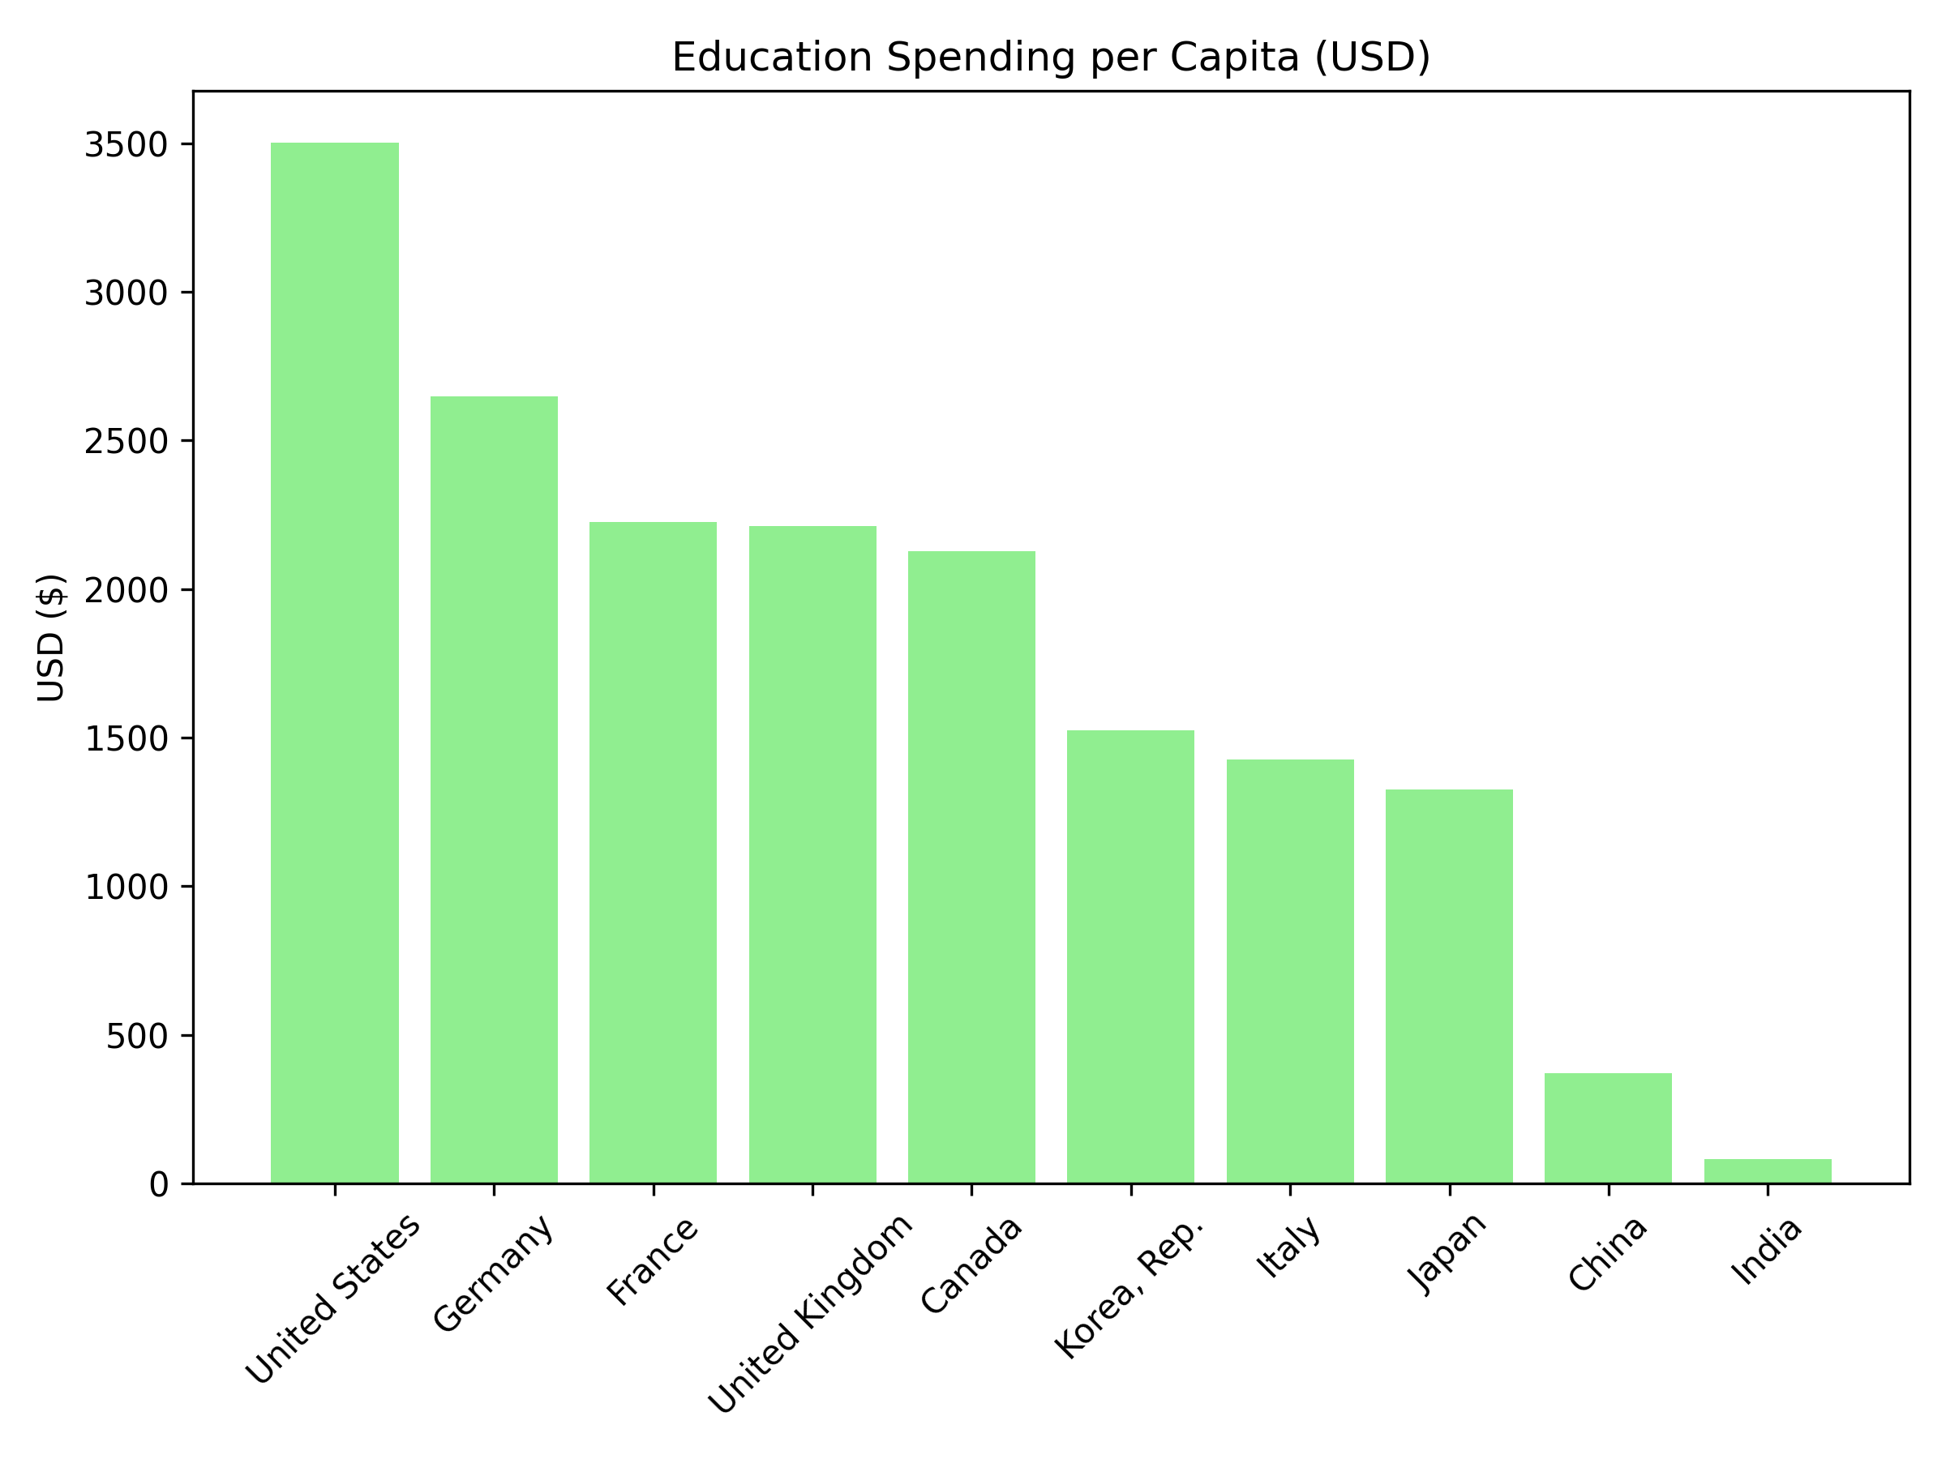
Education Spending per Capita
- Countries in descending order by USD

Slide 8
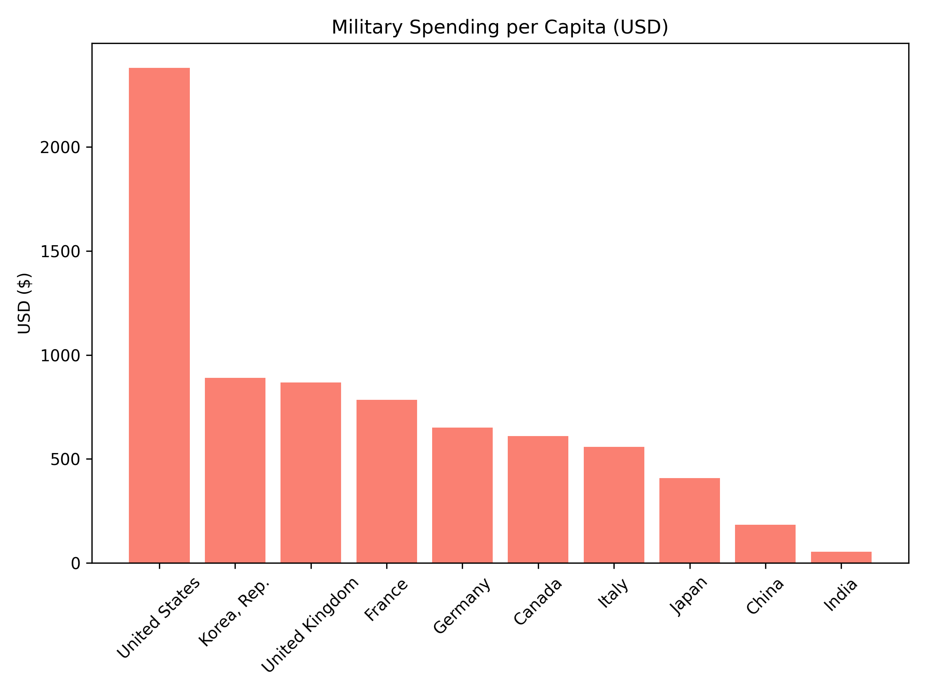
Military Spending per Capita
- Countries in descending order by USD

Slide 9
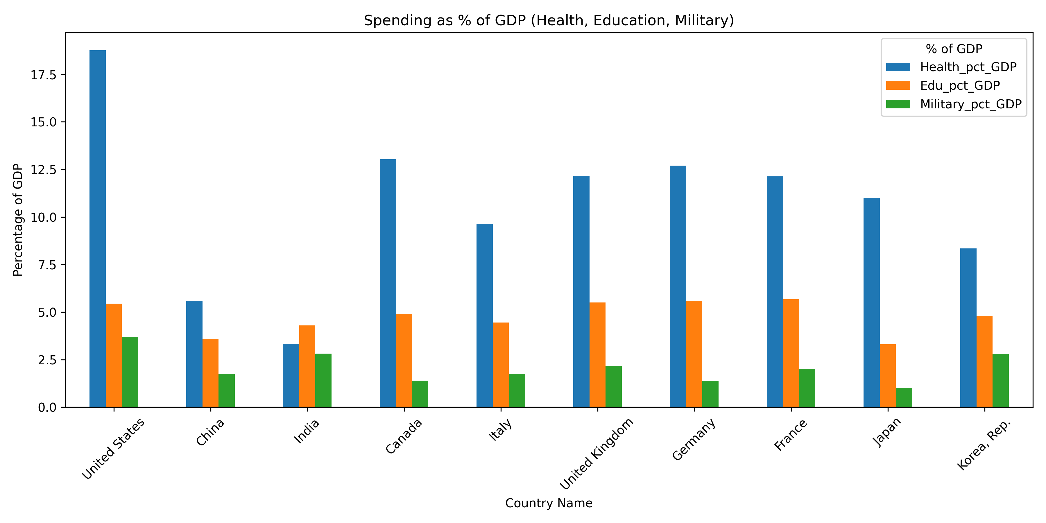
Spending as % of GDP
- Countries in alphabetical order

Slide 10
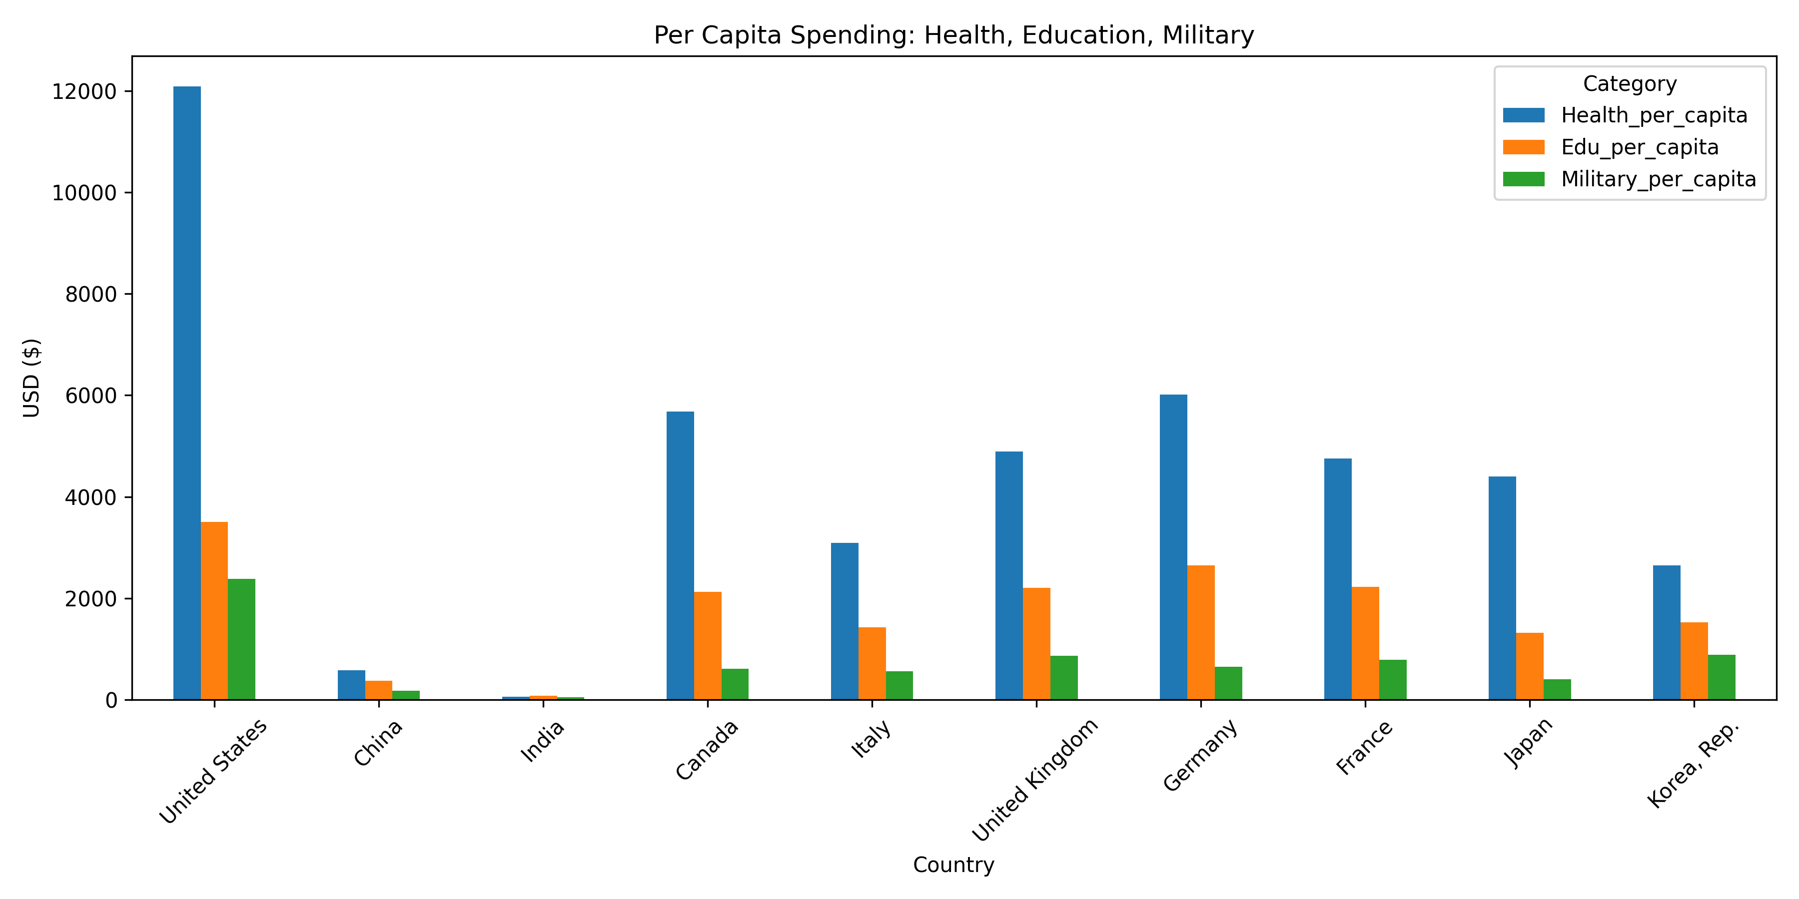
Combined Per Capita Spending
- Countries in alphabetical order

Slide 11
Key Findings
U.S. spends most per person across all sectors
Wealthier countries tend to spend more per capita
% of GDP differs—some invest more in social services, others in defense
Lower spending in some nations is tied to high population size or limited budgets

Slide 12
Conclusion
Government spending reflects national priorities
Strong health and education investment leads to long-term benefits
Military spending depends on regional threats and global positioning
Countries should aim for balanced investments to ensure sustainable growth

Slide 13
Resources
World Bank Open Data
SIPRI Military Expenditure Database
Python (pandas, matplotlib)
Google Colab

